Slide 1
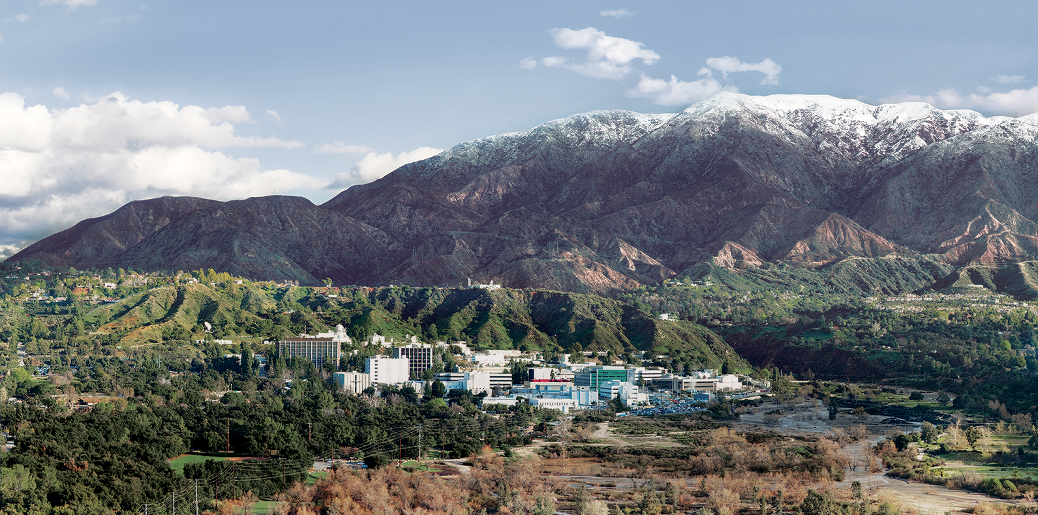
5. Matched filters for spectral signature detection
Dr. David R. Thompson
Jet Propulsion Laboratory, Imaging Spectroscopy Group

Slide 2
Goals for this module
Apply the Beer-Lambert law
Use adaptive spectral matched filters to detect subtle signals in radiance data

Slide 3
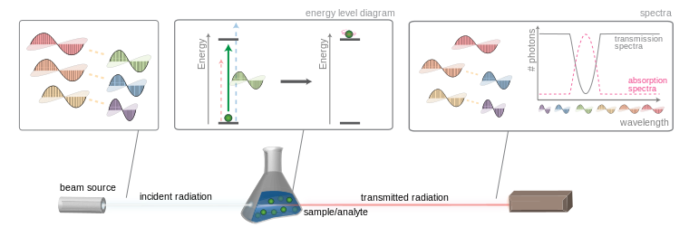
The Beer-Lambert law
The Beer-Lambert law describes how a homogeneous medium attenuates light. The result depends on the path length through the medium, and the material/s properties.
Wikimedia

Slide 4
The Beer-Lambert law
The Beer-Lambert law describes how a homogeneous medium attenuates light. The result depends on the path length through the medium, and the material’s properties.
Wikimedia
R_{out}(λ) = R_{in}(λ) e^{-κℓ}
Path length
Absorption coefficient (m⁻¹)

Slide 5


Trace gas measurement
In an atmosphere, an absorbing gas also attenuates sunlight according to the Beer-Lambert relation.
Mixing ratio length in ppm m
Transmission = $α$e^{- κ c x}
Mixing ratio
c
Absorption coefficient
x
Optical path length

Slide 6
Gas absorption signatures
Many bases have distinctive absorption features in the Near and Shortwave Infrared. Their magnitude is determined by the Beer Lambert law.
This plot shows atmospheric transmittance – i.e. the fraction of light that passes through the complete path from sun, to ground, to sensor.

Slide 7
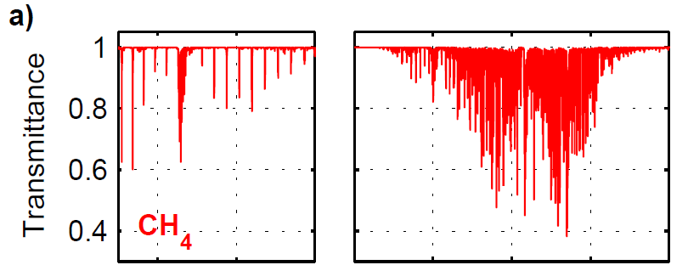
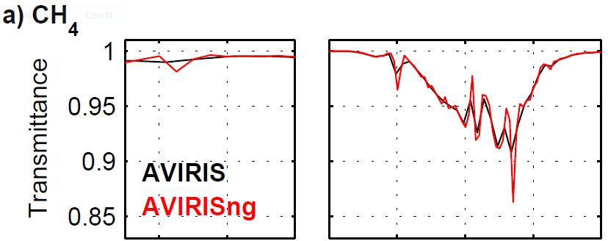
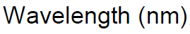
Gas absorption signatures
Each gas signature is comprised of many thin absorption lines from different quantum transitions in energy state.
The methane signature near 2.3 microns is easily measured by airborne VSWIR instruments.
The plot at right shows the absorption lines, and the downsampled version that appears to the sensor channels.
Methane
absorption lines
Measurement by two sensors

Slide 8
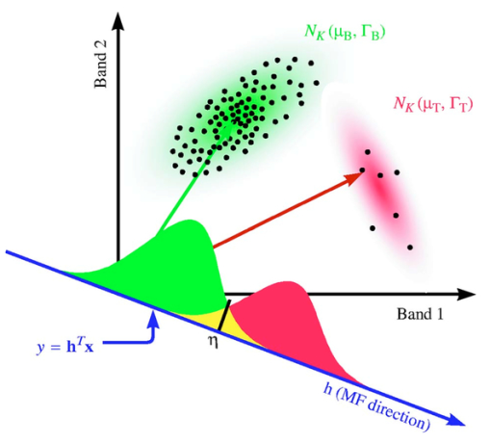
Matched filter intuition
The matched filter is a method for measuring the match with spectral signatures like the CH₄ absorption.
It is a geometric projection (similar to the spectral angle measure), but it is modified to account for the covariance structure of the background.
Image from [Dimitris G. Manolakis, Optical Engineering, 44(11), 116401 (2005). https://doi.org/10.1117/1.2125487]

Slide 9
Detection via matched filter
Mixing ratio length
Tested spectrum
Background mean
Background covariance
target

Slide 10
Detection via matched filter
Here is the projection onto the target
Normalization factor
Mixing ratio length
Tested spectrum
Background mean
Background covariance
target

Slide 11
Detection via matched filter
Here is the projection onto the target
Normalization factor
Mixing ratio length
Tested spectrum
Background mean
Background covariance
target
The target signature is the change in radiance caused by a unit increase in CH₄
Unit absorption coefficient

Slide 12
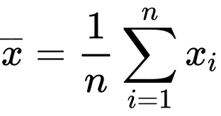
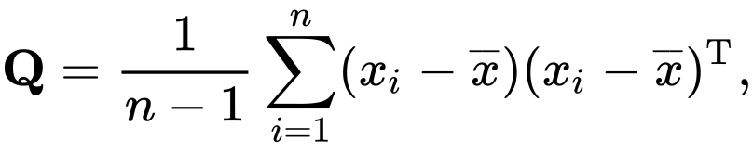
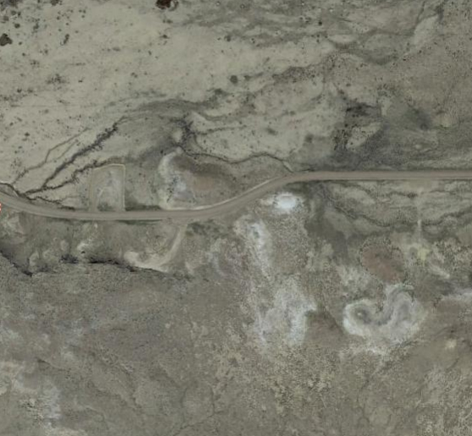
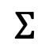
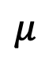
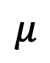
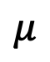
Estimating the background covariance
We estimate the mean and covariance from the scene itself.
$$μ$$
$$Σ$$
$$μ$$
$$μ$$
What sample set to use? There is no “right answer.” Try to find a region that is representative of your test spectrum, and that has sufficient samples to estimate the covariance accurately. Some typical representative areas might be the whole image, a square centered on the test spectrum, a column of data, or a cluster of similar radiances selected by a clustering algorithm.
Sample set
Sample set
Sample set
or
or
or…

Slide 13
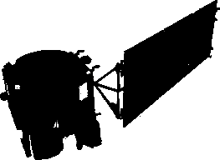
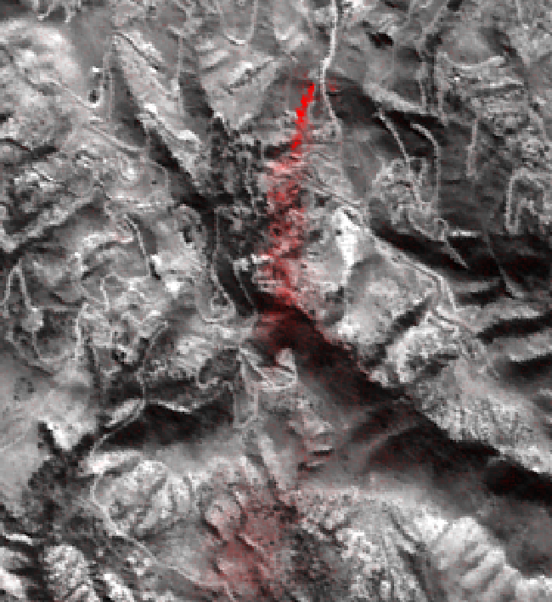
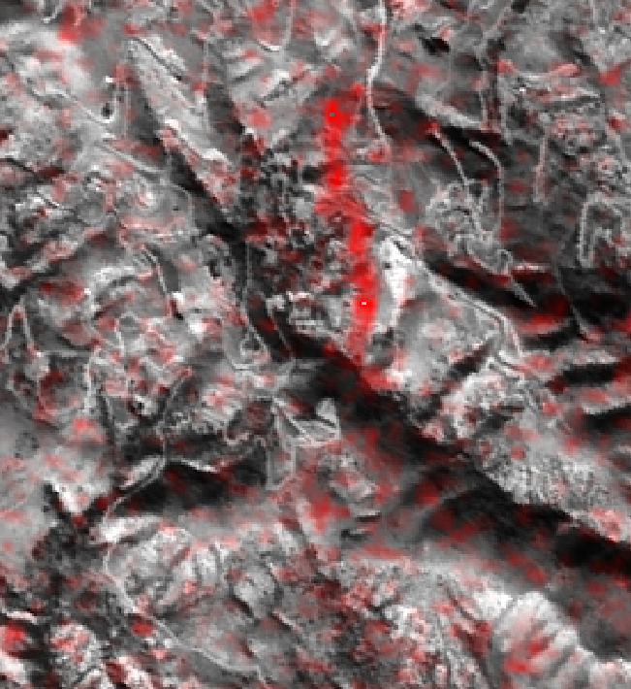
CH₄ detection at Aliso canyon
ER-2 at 6.6 km altitude, 1/12/2016
EO-1 Spacecraft at LEO, 1/1/2016
500 m
N
Thompson et al., Geophys. Res. Lett. (2016)

Slide 14
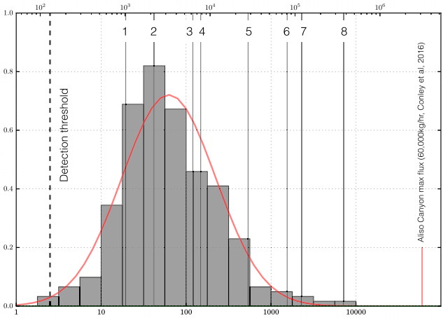
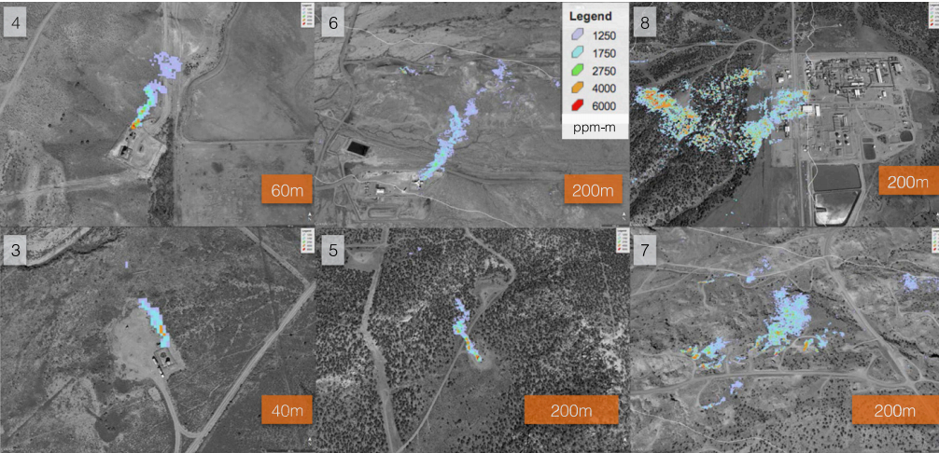
Fugitive CH₄ emissions at Four Corners, NM
Frankenberg, Thorpe, Thompson et al., PNAS 2016

Slide 15
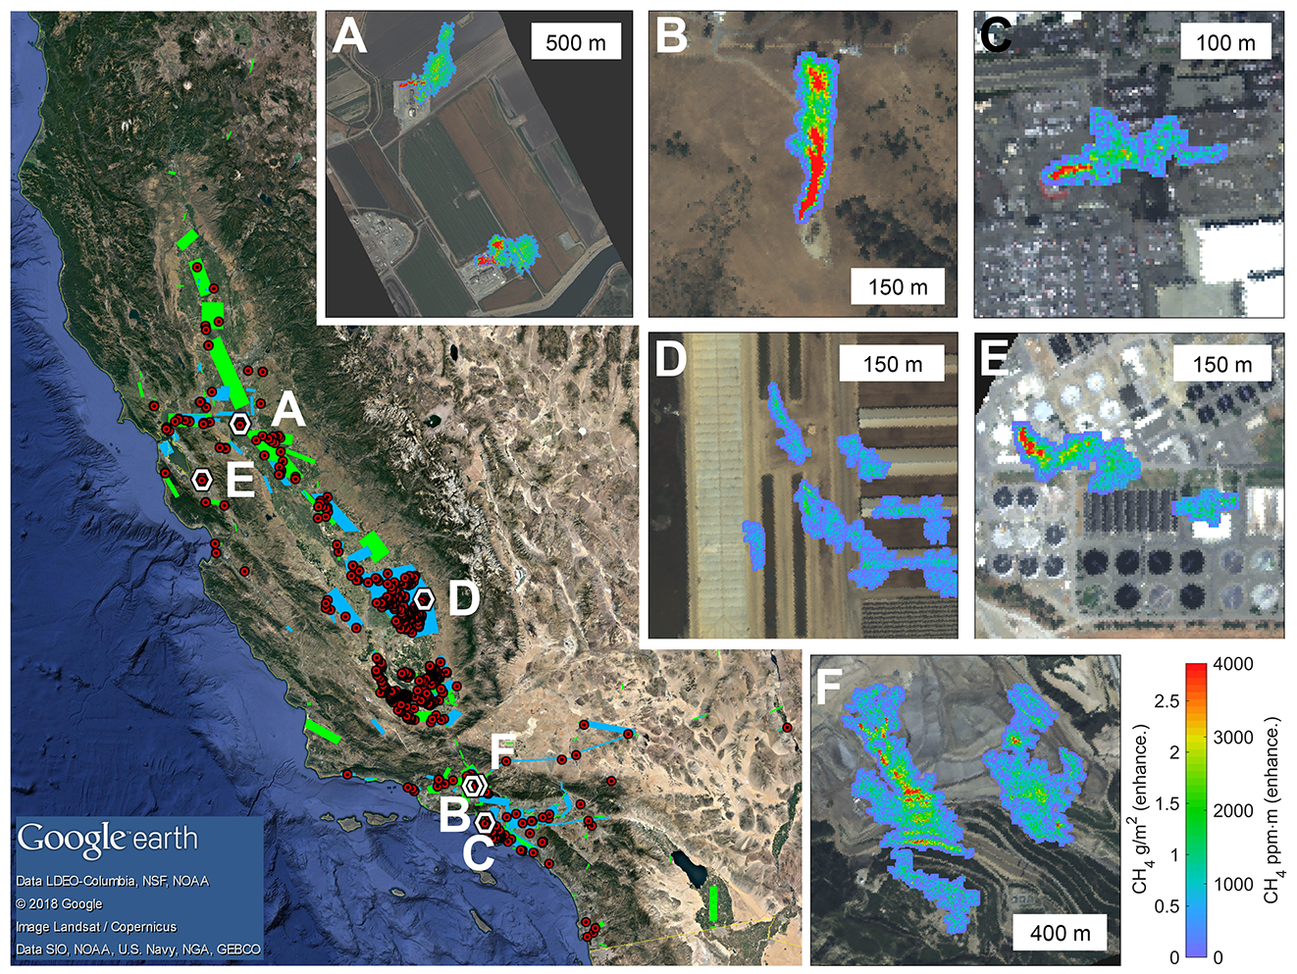
CH₄ in California
Duren et al. (2019). Thorpe et al. (2016), Thompson et al. (2015)

Slide 16
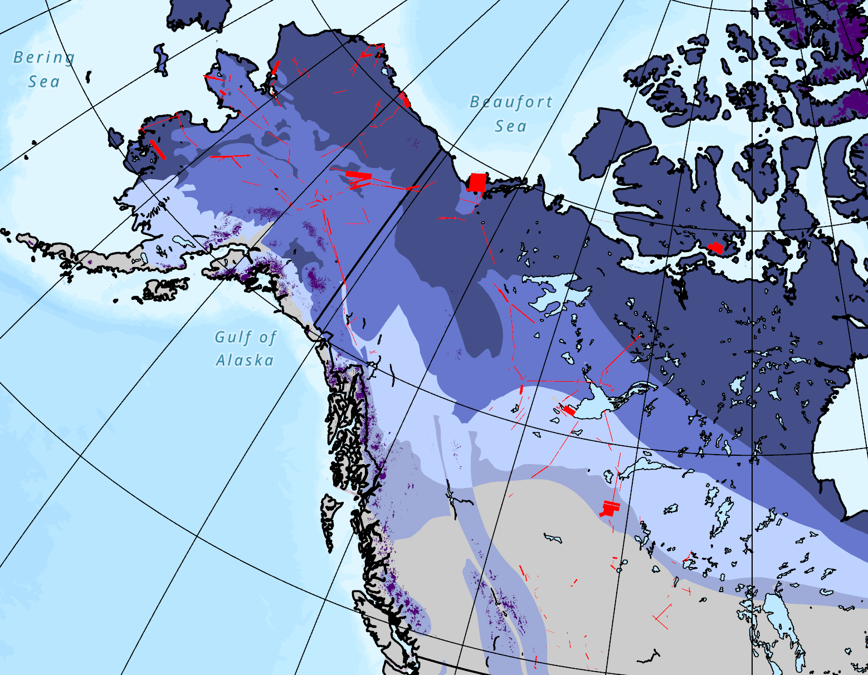
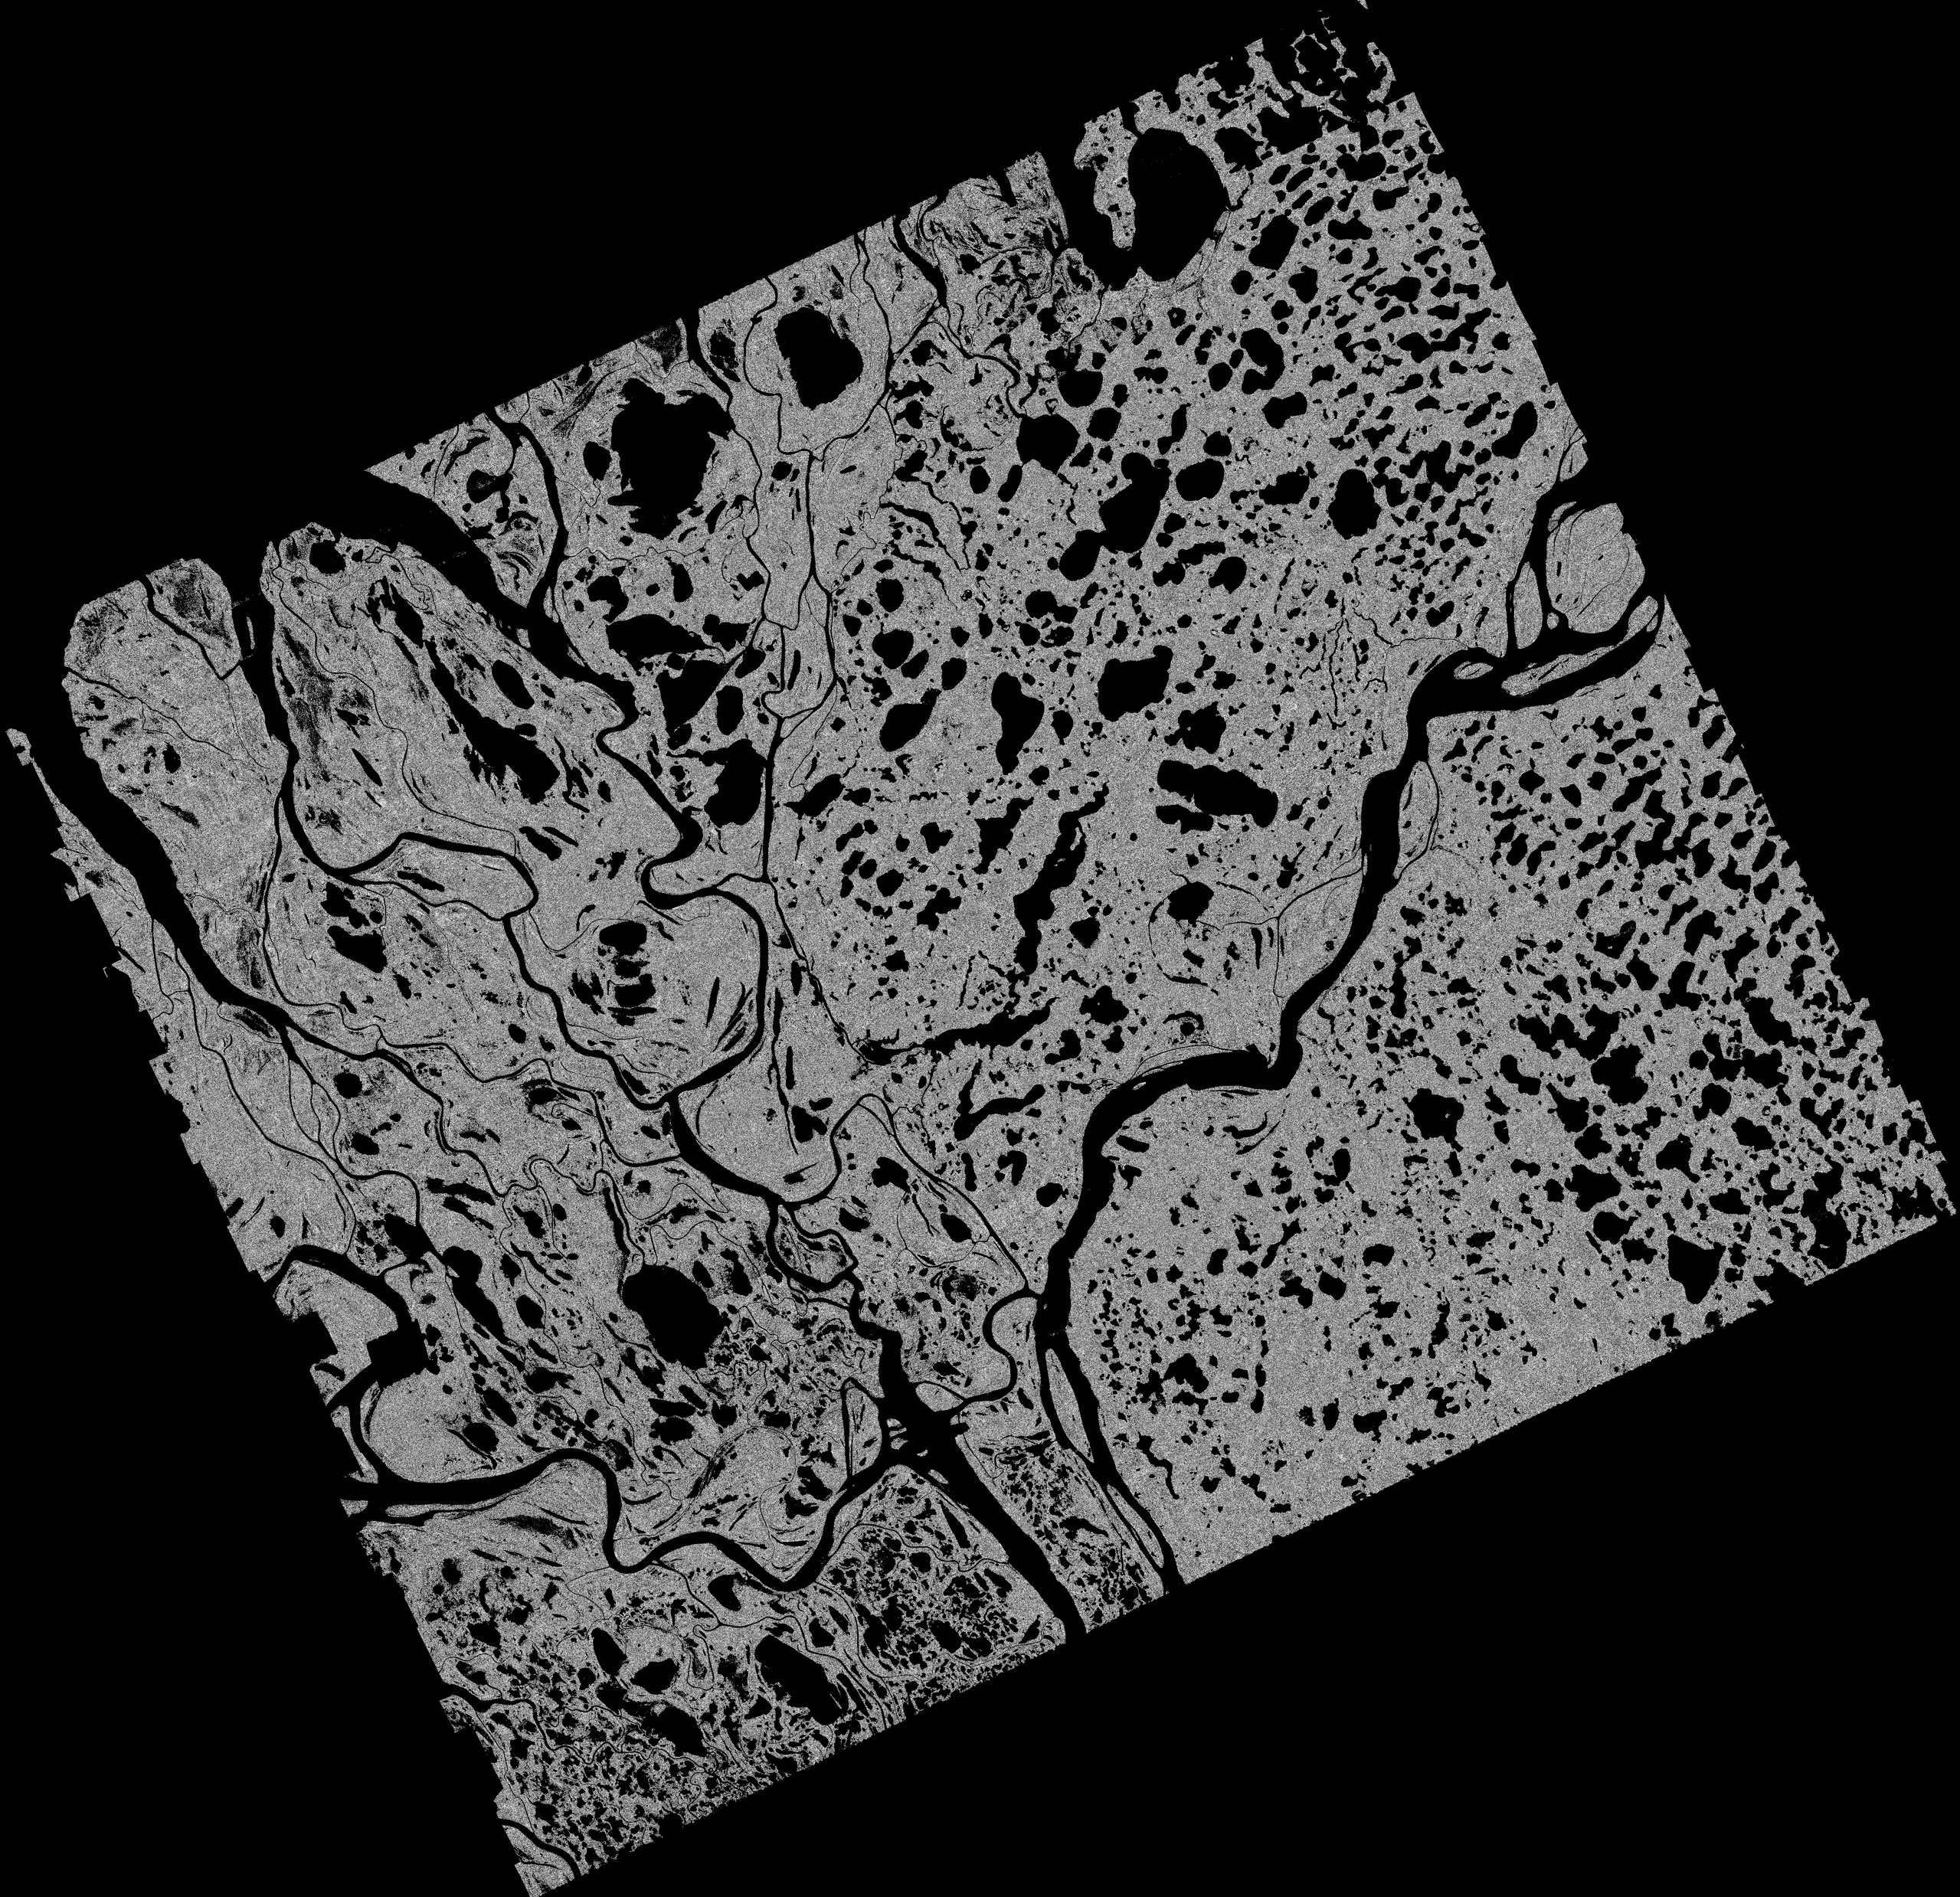
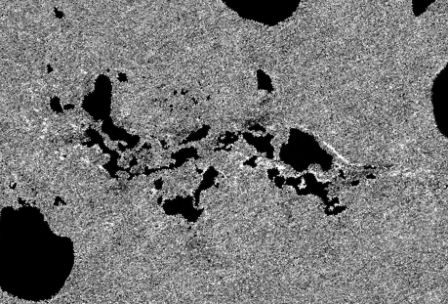
Arctic CH₄ Emissions Elder, Thompson, et al. Geophys. Res. Lett., 2020
145° W
60° N
10 km
1 km

Slide 18
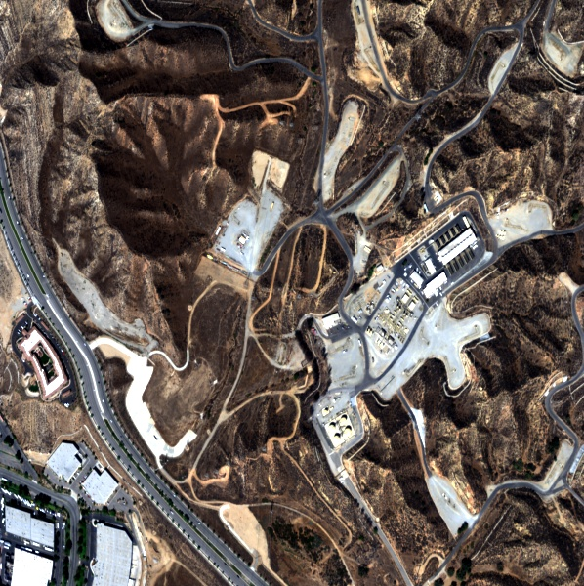
Exercise 6: CH₄ signature detection
Objective: Identify, and determine the source of, a fugitive CH₄ emission from a petrochemical facility.
The image at left is a non-orthorectified image from an AVIRIS-NG flight in 2016. Apply a background-whitened matched filter using the target signature of methane absorption (the file named ang_ch4_unit_3col_425chan.txt).
Find the CH₄ enhancement. What is the source location, and what is the maximum enhancement in ppm m?
Extra credit: try some different strategies for estimating the background covariance and non-enhanced radiance

